Slide 1
SAN FRANCISCO ONE SYSTEM
COORDINATED ENTRY ORIENTATION- SFHOT

Slide 2
Learning Objectives
Welcome
Name, pronouns, and one word for what home means for you
Understand SFHOT roles and tasks as they relate to Coordinated Entry
Gain an understanding of how to complete:
  Coordinated Entry Enrollment
  Adult Primary Assessment
Observe Access Point workflow in the One System
Notes:
Welcome
Introductions
Timeline for the day
Review Learning Objectives

Slide 3
Logging into the Training Site
URL: onesf-train.clarityhs.com
Username:Train#
  # = the number assigned during the count off (15-35)
Password: GoGi@nt5

Slide 4
Workflow
Client Engagement
Client goes directly to an Access Point or connects with an outreach worker
Complete the Coordinated Entry Enrollment
If the client is experiencing homelessness and in SF, complete the Coordinated Entry Enrollment in ONE.
Complete the Housing Prioritization Assessment
If Problem Solving is unsuccessful, the Housing Prioritization Assessment is completed.
Complete the SFHOT Enrollment
The SFHOT outreach team completed the PATH or Non-PATH program enrollment in ONE.
Problem Solving
Problem solving is always the first attempt to resolve someone's housing crisis

Slide 5
Client Engagement

Slide 6

Client Engagement
Client Engagement - Connecting with Coordinated Entry
Client goes directly to an access point
Clients are encountered by outreach workers
  SFHOT
  Mobile Access Points
SFHOT case managers will engage adults including youth in the CE process
  Families are encouraged to visit a family access point
Notes:
Clients may initially engage by an outreach worker (SFHOT or mobile AP) or by going directly to an AP

Slide 7
Program Enrollment-SFHOT
SF HOT Outreach Staff:
Creates a client profile
Completes the SF HOT PATH or Non PATH enrollments at time of engagement
SF HOT Case Management Staff:
Completes CE enrollments
Conduct problem solving
Conducts CE assessments
Notes:
Most or all of the clients should have already engaged with an outreach worker prior to meeting with the case manager. The outreach worker should have already created a client profile and complete the SFHOT enrollment.
If this was not done, the case manager would want to complete these steps.

Slide 8
Coordinated Entry Enrollment

Slide 9
Coordinated Entry Enrollment
For clients who are experiencing homelessness and in SF, a Coordinated Entry program enrollment is completed in ONE.
Enrollments are completed to show that clients are actively being engaged by the Homeless Response System
Not all users can see the assessment
Eliminates duplication of staff efforts and burden on the client
  Information carries forward to other fields in ONE
HUD requirement
Notes:
Shows clients are engaged with the CE system
Not all users can see the assessment so seeing the enrollment is another clue they are connected to CE
Reduces clients completing more than one assessment or visiting multiple access points
Eliminates administrative burden on staff- information cascades from the enrollment into other forms

Slide 10
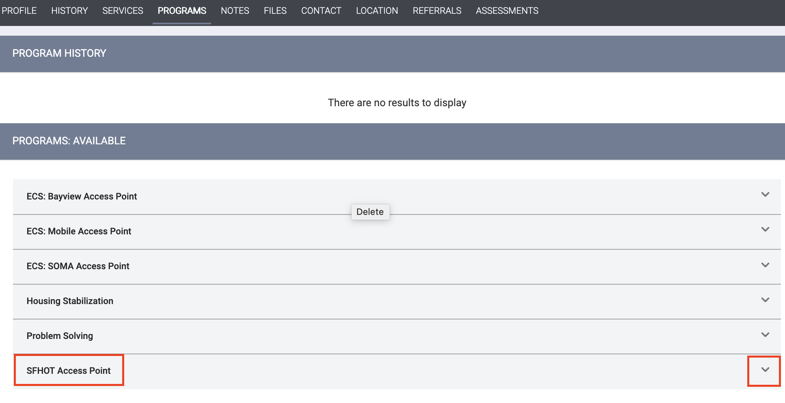
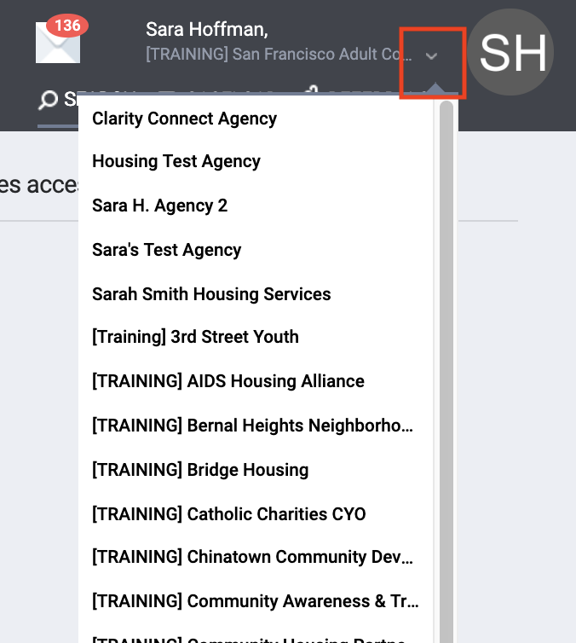
Coordinated Entry Enrollment
All work for Coordinated Entry is done under the Adult Coordinated Entry Agency
Enroll into the SFHOT Access Point Program

Slide 11
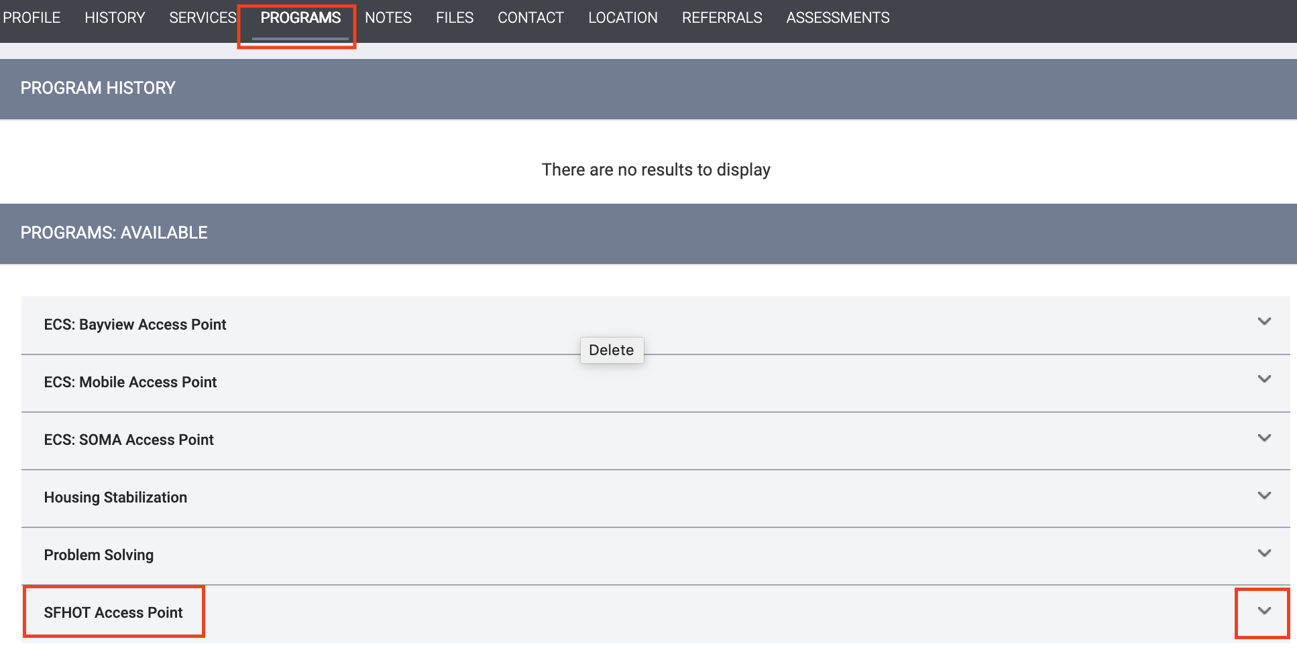
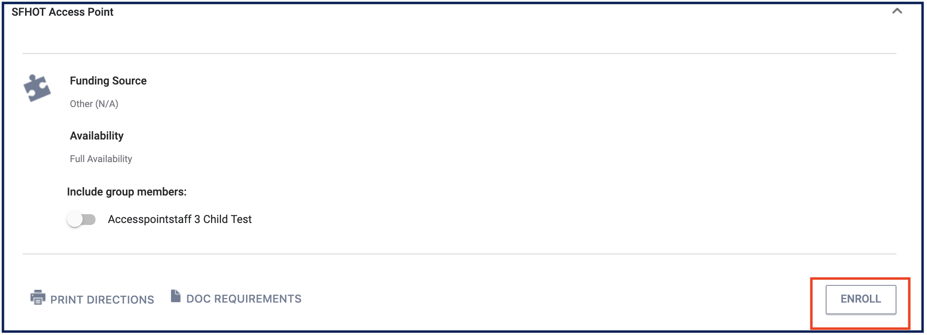
Coordinated Entry Enrollment
Click on Programs Tab
Click the drop down to the right of the SFHOT Access Point Program

Slide 12
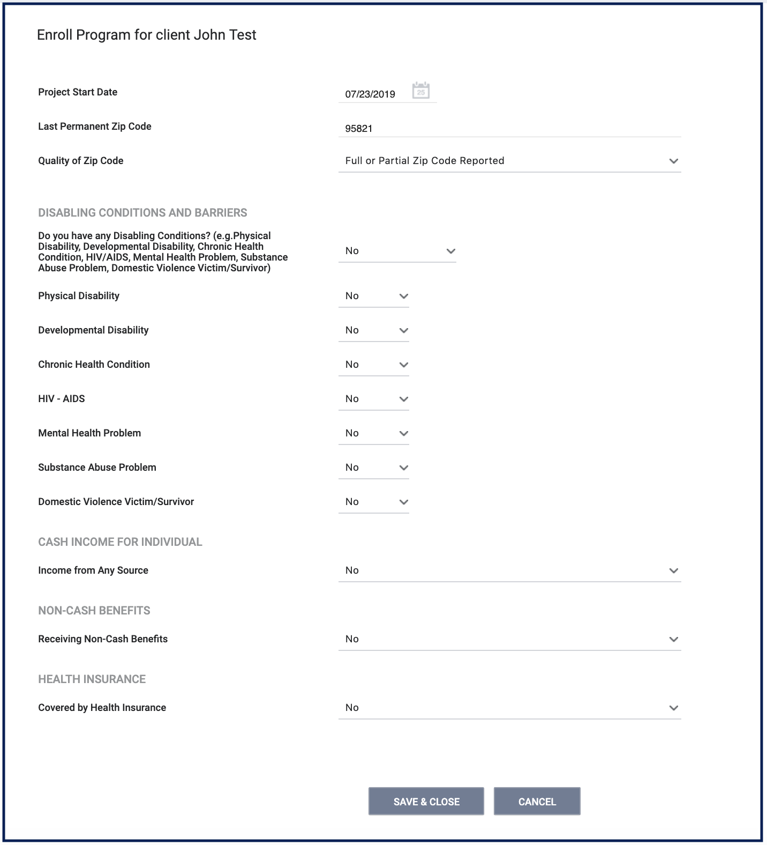
Coordinated Entry Enrollment
Complete the program enrollment questions, collecting as much information from the client as possible
Edit the form and add additional information if collected at a later date

Slide 13
Problem Solving

Slide 14

Problem Solving
Collaborative conversations to explore and plan housing solutions outside of the Homelessness Response System
  Problem solving is always the first attempt to resolve someone's housing crisis
Problem Solving can be cyclical
  Client may visit Problem Solving multiple times before finding a sustainable solution
  If unsuccessful, the client is given the housing prioritization assessment (primary assessment)
Various categories of Problem Solving Services
    Legal
    Financial
    Move-in assistance
    Conflict Resolution
Notes:
PS is always the first attempt in trying to resolve a households housing crisis.
PS can actually can be cyclical and can occur at various stages throughout the CE process.
A client may revisit PS multiple times before identifying a sustainable solution.
PS isn’t currently being tracked in ONE, but we are working with Bitfocus to determine a process and workflow. More details and training to come.

Slide 15
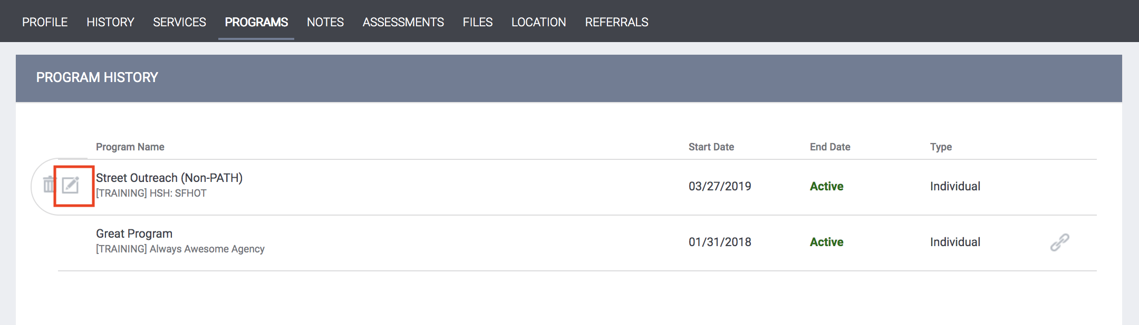
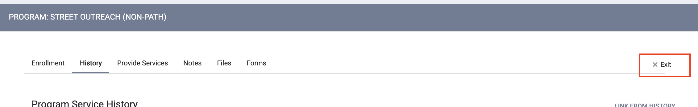

Program Exit
This only applies to clients who resolved their housing crisis though Problem Solving
Open the program enrollment, click exit.

Slide 16
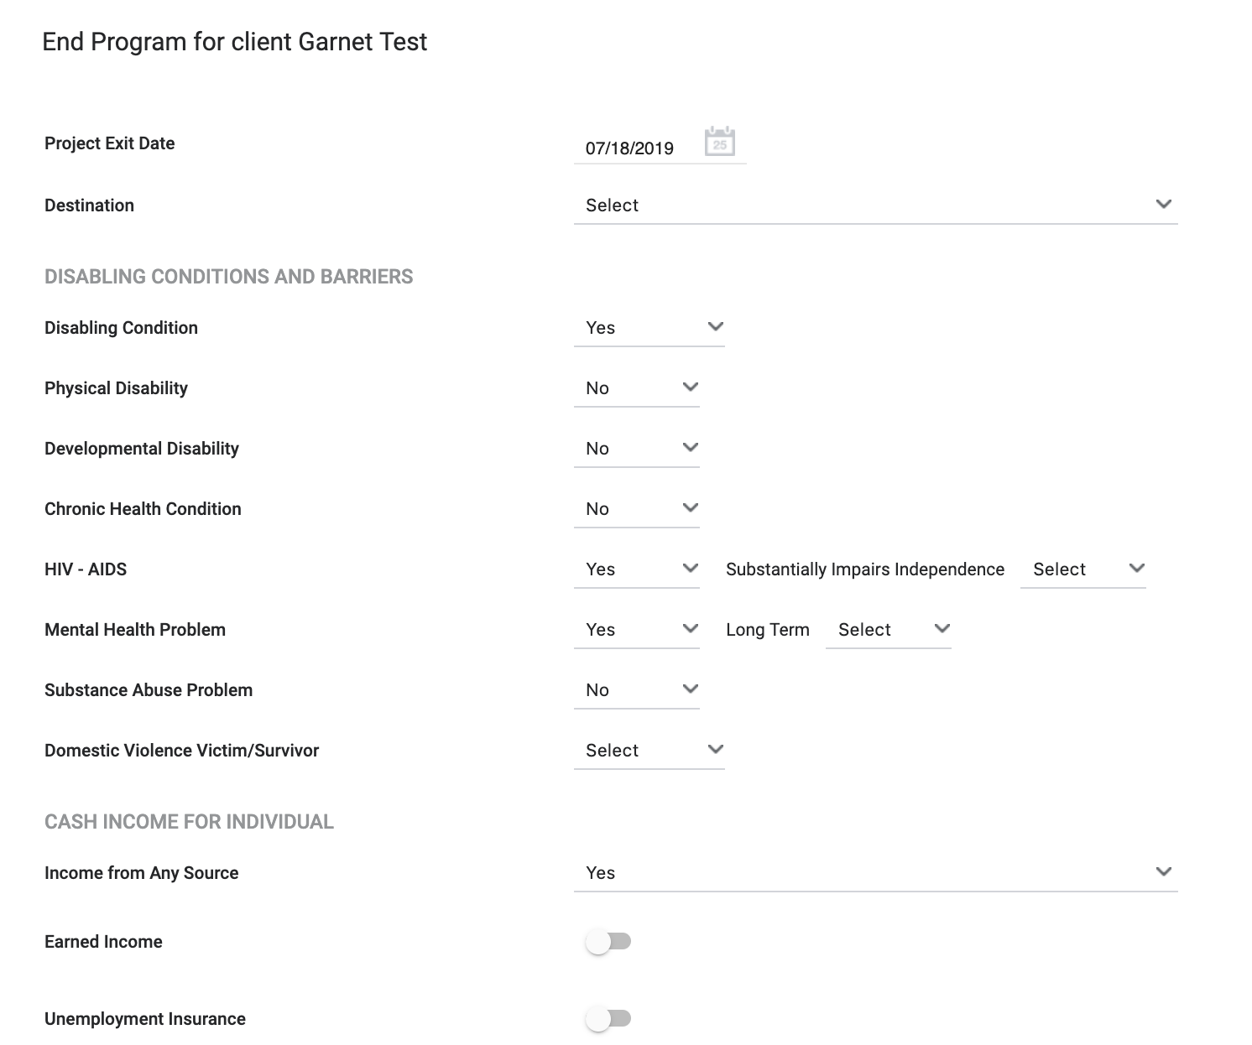
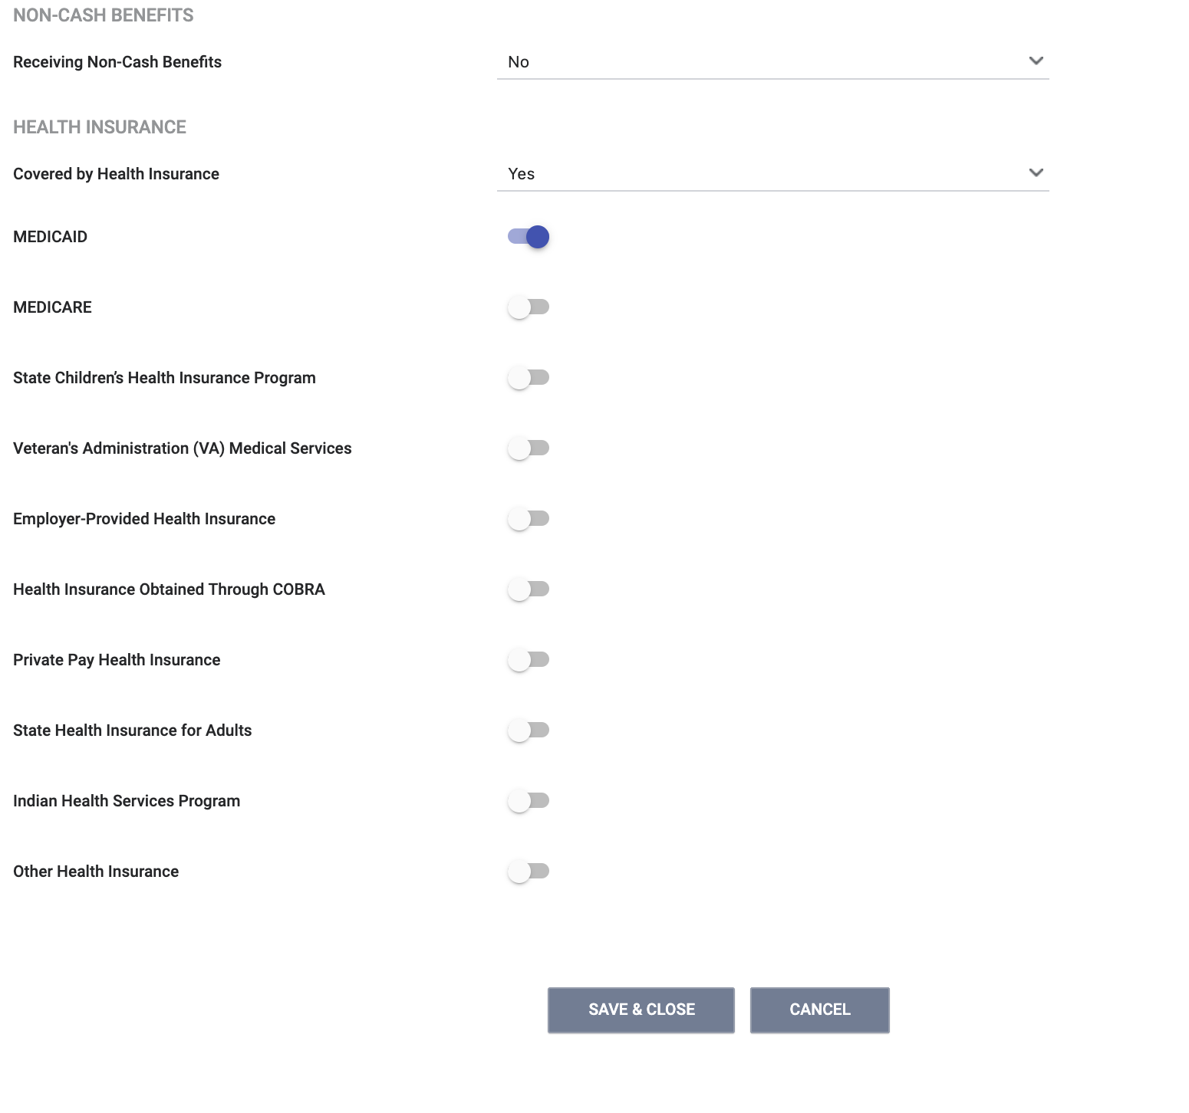
Program Exit
Complete all fields in the exit form and click “Save and Close”

Slide 17
Adult Prioritization Assessment

Slide 18
Adult Prioritization/ Primary CE Assessment
Does NOT guarantee eligibility for a housing resource
The assessment is not visible to all ONE users
Evaluates an adult’s possible health vulnerability, housing barriers, and homelessness chronicity
Determines prioritization for housing resources: priority status vs. non-priority status
Completed for clients that did not resolve their homelessness via problem-solving
Notes:
The assessment evaluates an adult’s possible health vulnerabilities, housing barriers and homeless chronicity
Completed for clients that did not resolve her/his homelessness via problem-solving
The assessment is also used to determine priority status vs. non-priority status
Does not guarantee a housing resources

Slide 19
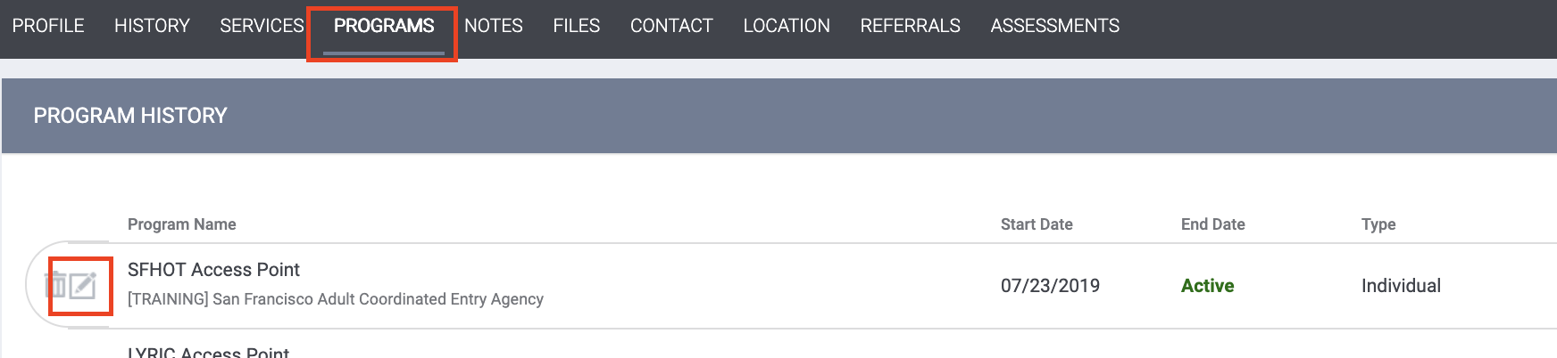
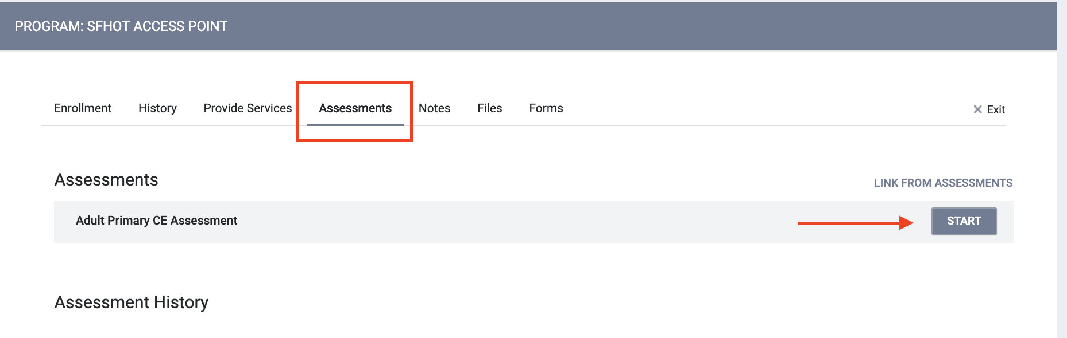
Adult Prioritization/ Primary CE Assessment
Go to the “Programs” tab
Open the SFHOT Access Point Enrollment
Go to the Assessment Tab
Click “start” for the Adult CE Primary Assessment

Slide 20
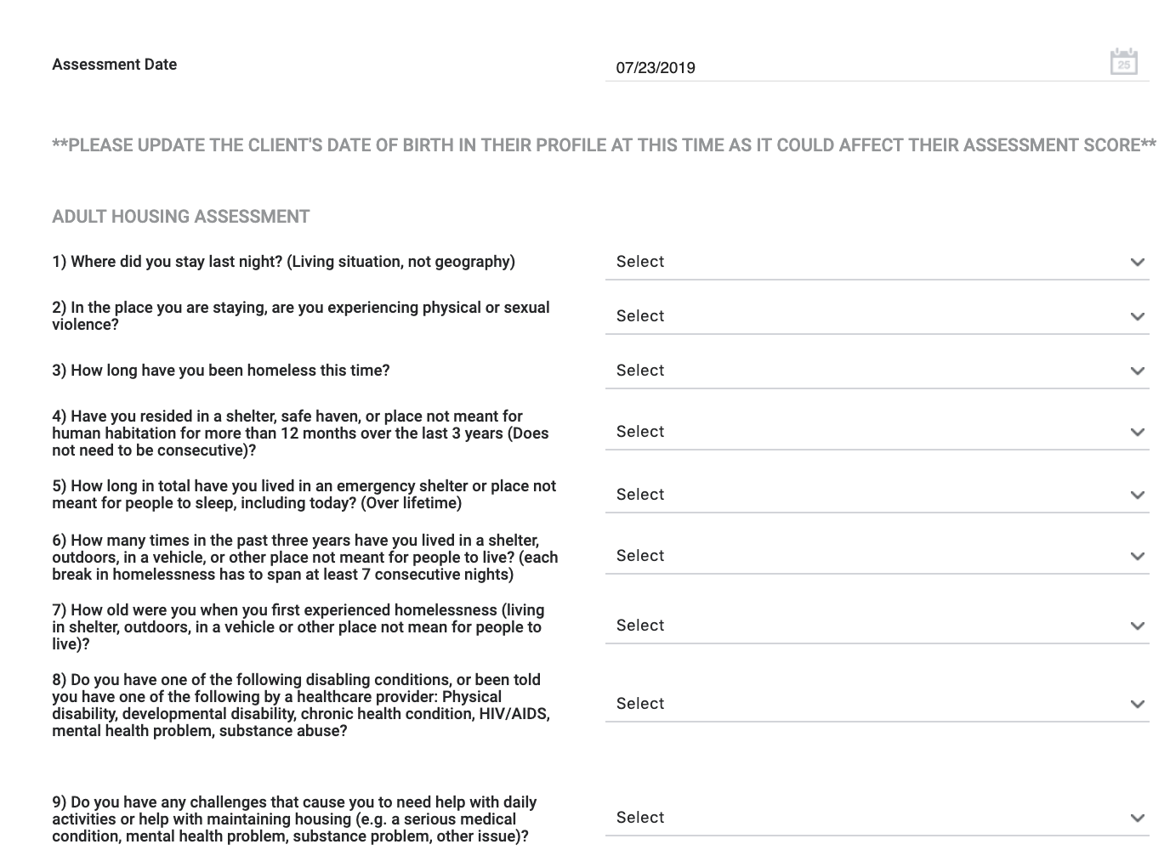
Adult CE Primary Assessment
Complete the fields in the assessment
Click Save

Slide 21
Priority Status
Determined by the Primary Assessment
Priority status households will get housing navigation and referral to HSH funded permanent housing
Non Priority Status household will not be referred to HSH funded permanent housing programs and will be offered problem solving again
Notes:
Priority status is determined by the Adult Primary Assessment
Client w/ priority status will be placed on the prioritization list (CQ)
Priority households will get housing navigation and referral to HSH funded permanent housing

Slide 22
Referrals to the Community Queue

Slide 23
Referrals Community Queue (CQ)
Client who are determined to have priority status are referred to the CQ
The CQ is comprised of client who are expected to be housed in 180 days
Inactive Threshold- client with no activity in the ONE system for 90 days will be removed from the CQ

Slide 24
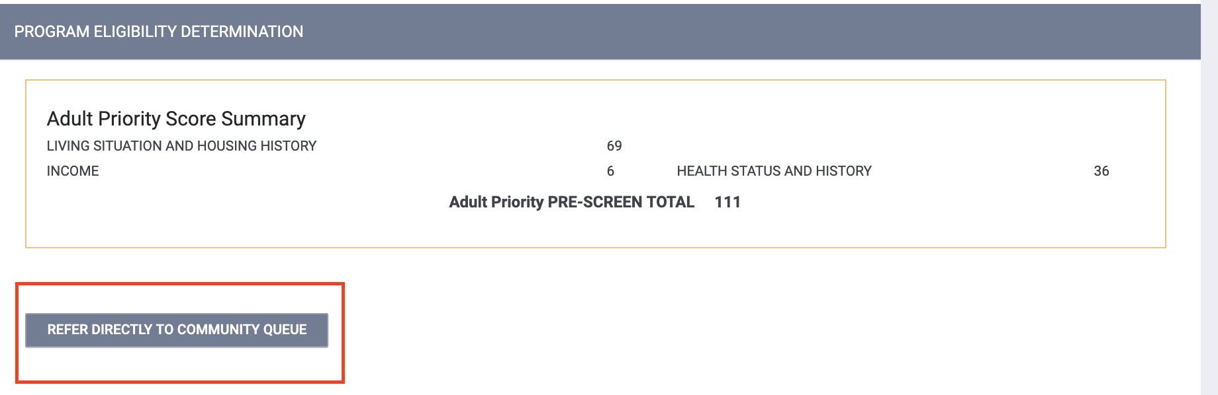
Referrals Community Queue (CQ)
If the client meet the criteria for priority status, click the “Refer Directly to the Community Queue” button.
Enter a note if needed

Slide 25
ONE System Alerts for Priority Clients
System wide alerts are set for clients with priority status
“This individual has engaged the Department of Homelessness and Supportive Housing’s Adult Coordinated Entry and is identified as Priority Status, which means this adult could be eligible for permanent supportive housing. . If you encounter or know how to contact this person, please immediately call ECS-ACES, the Adult Coordinated Entry program provider at 415-487-3300 ext 7000.”

Slide 26
What Happens Next

Slide 27
What Happens Next
Client who have priority status are referred to the CQ
  Housing Navigator is assigned to work with the client
Housing providers post open housing resources
Navigators matches eligible clients to available housing resources
Housing provider manages the status of the referral in ONE
  Pending I/P
  Accepts the referral (enrolls into the program)
  Deny the referral
Notes:
Clients with priority status are referred to the CQ
Navigators will help clients get document ready and navigate the application process once a referral is made
Housing Providers will post an open housing resource in ONE
Navigators will use functionality in ONE to match eligible clients to available housing resources
Housing providers will receive the referral in ONE. They will update the status of the referral so Navigators stayed apprised of the status of the referral

Slide 28
Complaints/Grievances
For complaints about CE:
Staff can contact Megan Owens, Coordinated Entry Manager, San Francisco Department of Homelessness and Supportive Housing
  Megan.owens@sfgov.org
Clients can file a grievance with Episcopal Community Services
  ECS’s main office for the AP is 123 10th Street, San Francisco, CA 94103
  Phone number: (415) 487-3300 ext 7000

Slide 29
Need More Help?
Supplemental training materials and “How to Guides” https://onesf.clarityhs.help/hc/en-us/articles/360015482654-Coordinated-Entry-Training-Materials-
Don’t forget the Helpdesk! onesf@bitfocus.com or 415.429.4211
Notes:
New web page containing CE supplemental training materials

Slide 30
Questions?

